Slide 1
CS309 Object-ORIENTED Analysis and DESIGN
Yuqun Zhang （张煜群）
Department of Computer Science and Engineering
Southern University of Science and Technology

Slide 2
Who and Where Am I?
Dr. Yuqun Zhang （张煜群）
Email: zhangyq@sustech.edu.cn
Office: Room 604, 创园10栋
Office Hours: 4-6pm, Thursday, or appointment by email

Slide 3
A little something about Me…

Slide 4
My Styles and Rules
Casual
Interaction
Mutual Respect
NO CHEATING!!!!!
You may work together in this class, as specified on each specific assignment. Do NOT use any resource without citation.

Slide 5
Instructor and Teaching Assistant
Yueming Zhu (朱悦铭)
Email: zhuym@sustech.edu.cn
Yicheng Ouyang (欧阳弈成)
Chao Pan (潘超)
Yuanhang Wu (吴远航)
Hengcheng Zhu （朱恒成）
Wentao Ning (宁文韬)
Zhiyuan Wang (汪至圆)
Paola Yanez
Jia Zou (邹佳)
Zexin Li (李泽鑫）

Slide 6
Textbooks
Freeman et al., Head First Design Patterns
Martin Fowler, Refactoring
Block, Effective Java
Zeller and Krinke, Essential Open Source Toolset: Programming with Eclipse, JUnit, CVS, Bugzilla, Ant, Tcl/TX and More
McConnell, Code Complete: A Practical Handbook of Software Construction
Pilone, UML 2.0 Pocket Reference

Slide 7

Evaluation and Grading
Weekly Lab Tutorials– 25%
~5 times
Project – 35%
Web applications
Group of 5 (before the end of next week)
3 presentations (proposal, progress, final)
2 written reports
Exams – 30%
Final:
What’s on an exam? Anything from any aspect of class, including lab sections.
No hints (重点）
In-Class Exercises/Attendance – 10%
Spontaneous (That means in general I do not call the roll. But I have my own moves )

Slide 8
Project in 2017 Fall

Slide 9
Project in 2018 Fall

Slide 10
You could say this is a “breathing” class (not a “水” class).

Slide 11

I just want you to be happy in this semester.

Slide 12
Alright, Let’s Get REal

Slide 13
Expectations
You’re going to have to “own” your education in this class
I have a feeling this is going to be an awesome semester…
But…
Expect that I may not be able to give you an immediate answer (I’m alright if my response to your question is “I don’t know,” so you’re going to have to be alright with that, too)
I (or the TAs) WILL always try to help find you the answers you need in a timely fashion. Be patient.

Slide 14
Tips of Handling Problems
Once you encounter problems (theory or practice), you are expected to
first, try your real best to solve them by yourself

Slide 15
Tips of Handling Problems
Once you encounter problems (theory or practice), you are expected to
first, try your real best to solve them by yourself
if not working, try to talk with your cohorts.

Slide 16
Tips of Handling Problems
Once you encounter problems (theory or practice), you are expected to
first, try your real best to solve them by yourself
if not working, try to talk with your cohorts.
if not working, then ask us

Slide 17
Tips of Handling Problems
Once you encounter problems (theory or practice), you are expected to
first, try your real best to solve them by yourself
if not working, try to talk with your cohorts.
if not working, then ask us
If we find that you are not paying effort by yourself, we would be reluctant to help you at later time.

Slide 19
What You Would Learn
Of course the object-oriented design and analysis
Typically, you are going to learn something about
requirement engineering (UML)

Slide 20
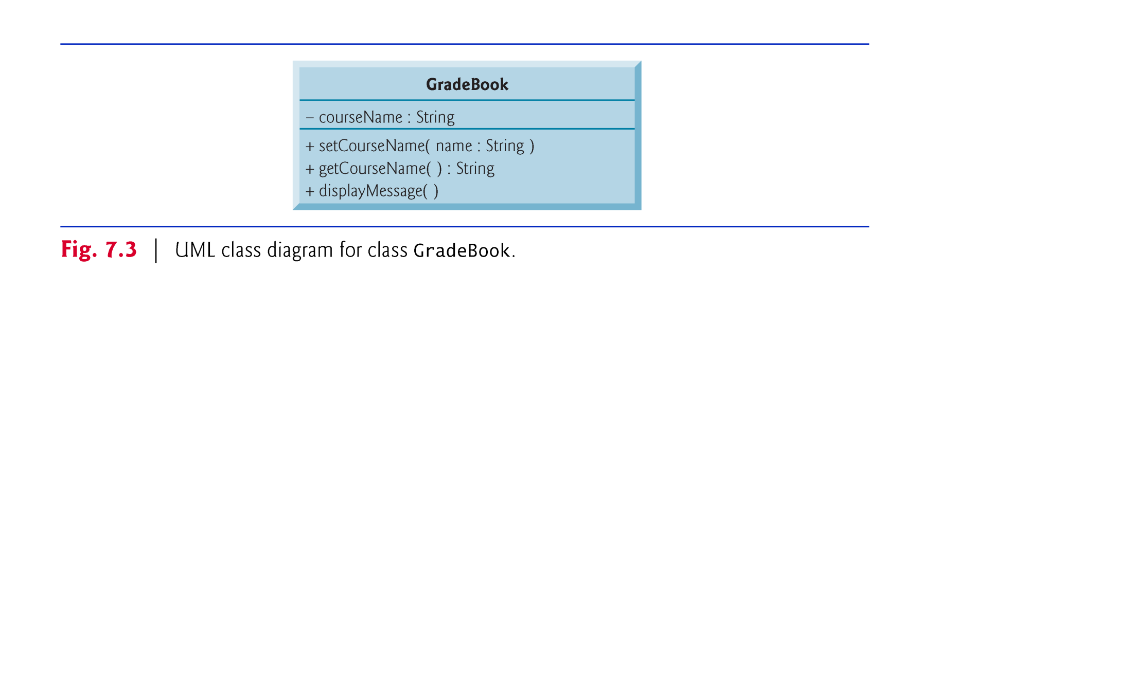
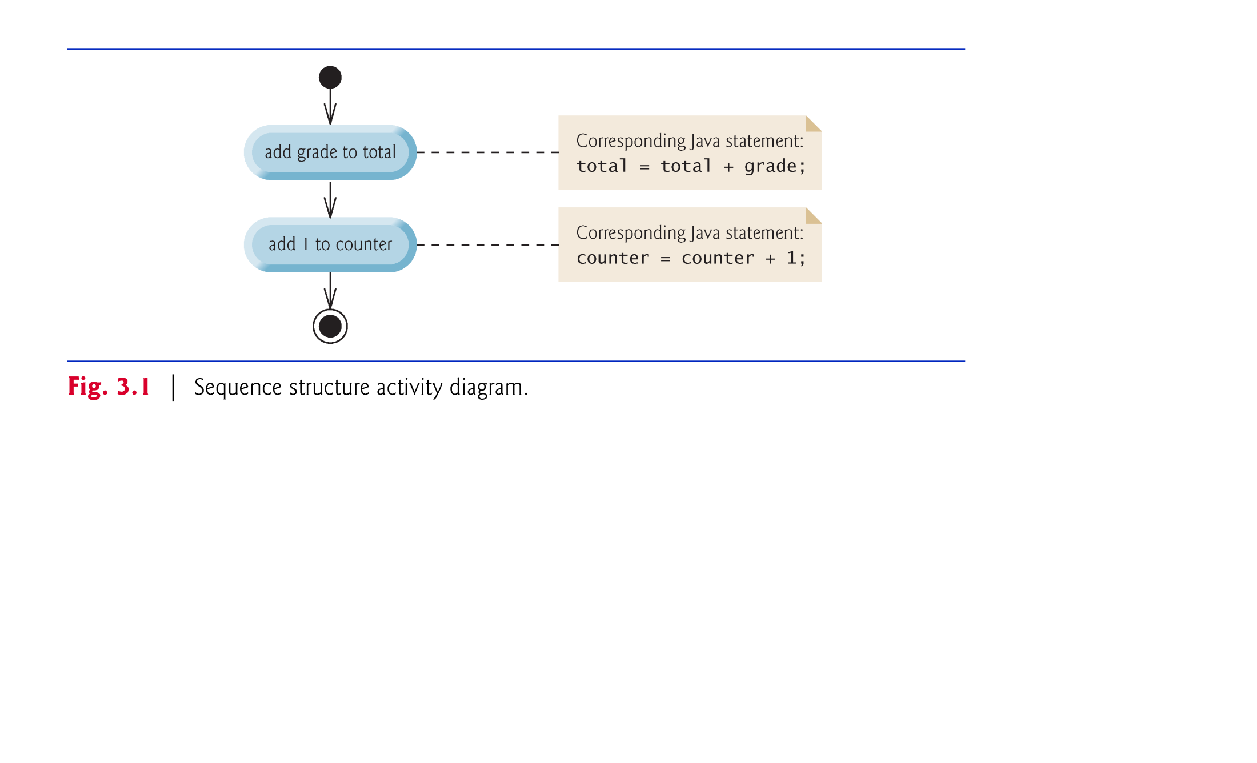
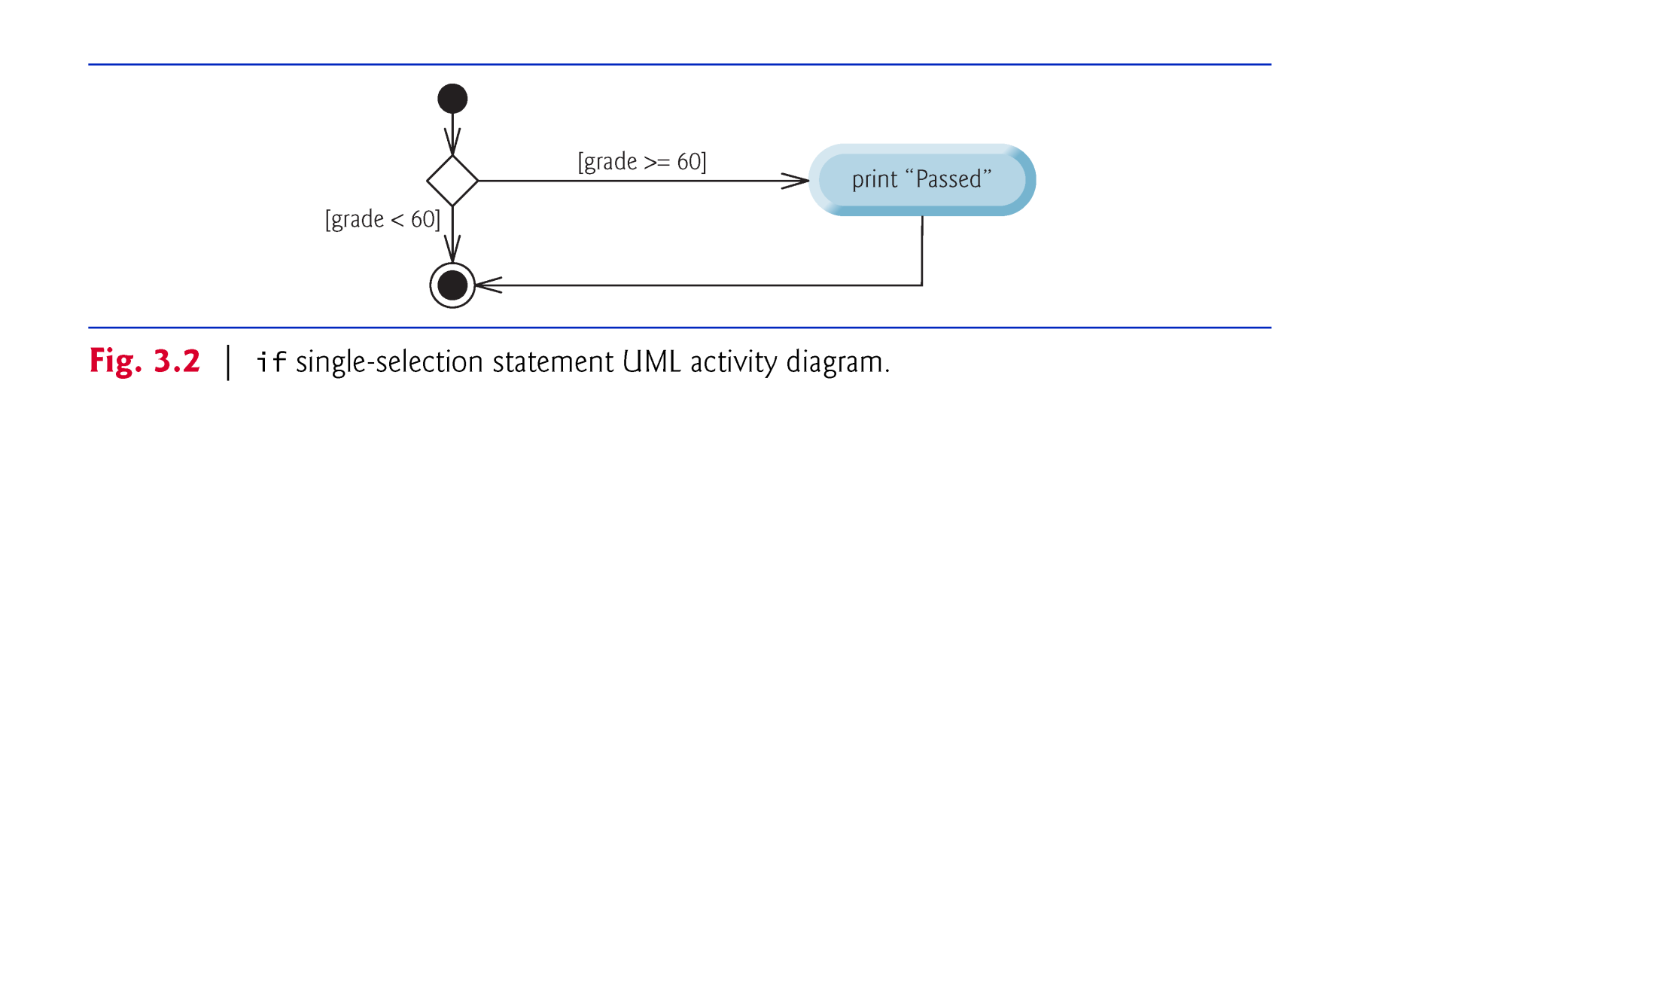
UML Examples

Slide 21
What You Would Learn
Of course the object-oriented design and analysis
Typically, you are going to learn something about
requirement engineering (UML)
design pattern (including information hiding, design principles,etc)

Slide 22
What You Would Learn
Of course the object-oriented design and analysis
Typically, you are going to learn something about
requirement engineering (UML)
design pattern (including information hiding, design principles,etc)
refactoring

Slide 23
What You Would Learn
Of course the object-oriented design and analysis
Typically, you are going to learn something about
requirement engineering (UML)
design pattern (including information hiding, design principles,etc)
refactoring
web app frameworks? testing?

Slide 24
Your Projects
Each group picks one problem from a pool

Slide 25
Your Projects
Each group picks one problem from a pool
We created 6 projects for you. Yet you can work on your own if you want to.

Slide 26
Your Projects
Each group picks one problem from a pool
We created 6 projects for you. Yet you can work on your own if you want to.
Come talk to me if you want to come up with your own ideas. DO EXPECT THAT YOUR IDEAS MIGHT BE WITH A LOWER STARTING SCORE.
One contact person is needed for each group.

Slide 27
The Project List
The Legendary Mozart: Build an RPG game with Mozart's life events as its storyline (collaborated with Central Conservatory of Music, 35% + 5%).
SUSTeMahjong: Build a Mahjong Game with SUSTech background.
Courschema: Build a website that easily derive the course schema uploaded by multiple departments in SUSTech (collaborated with Office of Educational Administration of SUSTech).
BetterOJ: Build a comprehensive online judge system that can be easily adopted by multiple CSE courses.
Algorithm store: An online store where users can customize smart logics algorithms and run them in server (collaborated with the Peacock team in CSE).
SUSTech Doc: An online sharing doc website for SUSTech users.

Slide 28
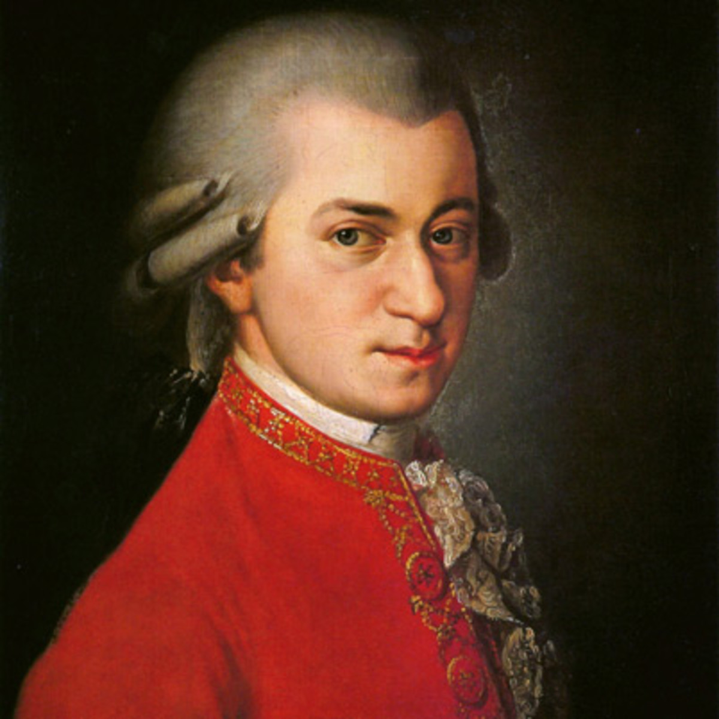
The Legendary Mozart:

Slide 29
The Legendary Mozart:
An RPG game with the leading role of first/third person perspective
Mozart's life events as basic storyline (e.g, his birth, growth, composition of his famous work)
You don't know the details? No worries, Central Conservatory of Music provides the story scipt.
Highly refined images. You can outsource them to professionals if you want to. Contact us if you need financial support but the funds are limited .
Students with expertise in both game programming and music are encouraged to form such teams.
Need to have faith, especially because this project is really harsh.
Bonus hits:
One or more branch games are needed to enrich the game.
Fancy GUIs are favored
…

Slide 30
The Legendary Mozart:
Labor recommendation
Resource provider (art designer)
Scenario designer
GUI designer
Game logic designer
Or other roles determined by you
Materials
You can refer to the .pdf file “南科大－莫扎特音乐游戏脚本”
Stakeholder for Requirements:
Prof. Cong Kong, Ms. Dongning Yang (CCM)
Yicheng Ouyang, Chao Pan

Slide 31

SUSTeMahjong

Slide 32
SUSTeMahjong
Build a Mahjong Game with SUSTech as background.
You need to change the elements of traditional Mahjong. For example, replace Strip Pie and Ten Thousand (条、饼 和 万) with departments, courses, or teaching buildings etc.
You can change the rules of traditional Mahjong, but make sure that your game is a Mahjong Game. That means the winner policy and the game process should align with the traditional Mahjong.
Human vs. Human mode is required. Other modes are optional and bonus.
Reminders
Design your game policy as funny and reasonable as possible
Make sure that your game logic stays positive, otherwise you would be forced to give up on your ideas.
Fancy GUIs are favored
...

Slide 33
SUSTeMahjong
Labor recommendation
Resource provider (art designer)
Algorithm designer
Game logic designer
GUI designer
Or other roles determined by you
Stakeholder for Requirements:
Yuanhang Wu

Slide 34
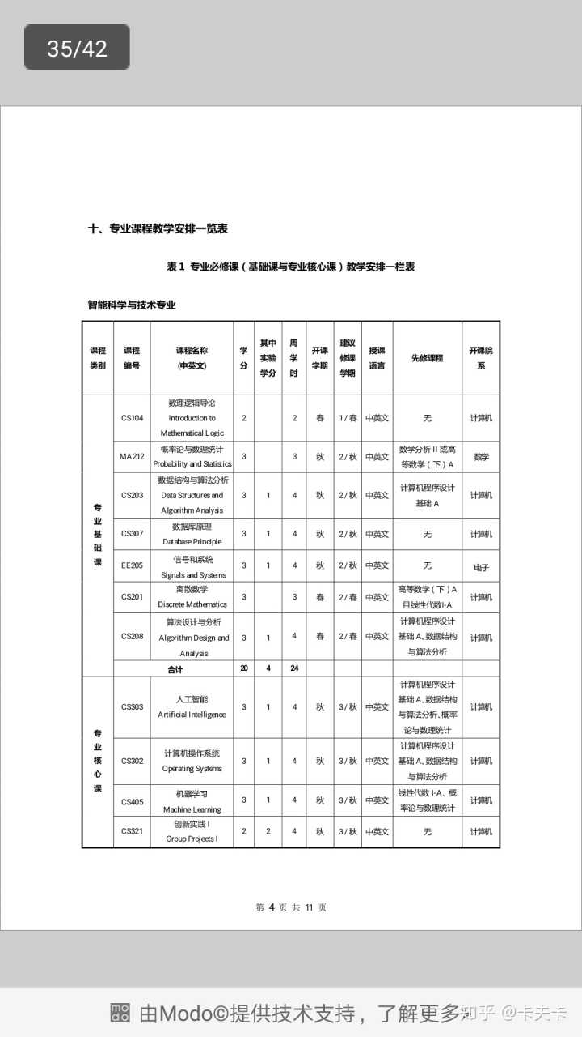
Courschema

Slide 35
Courschema
Users (e.g. Teaching secretaries or others) can upload course schemas by filling a uniform template or adding courses into website directly.
The download format of course schemas needs to be unified.
For website visitors, given the input keywords such as ‘department’, ‘academic year’, etc., the website can return how many courses are required for learning. When loging in the website by a student account, it can return which courses he/she has learned or not.
Design an approach to solve the inconsistencies in course schema appearances among all departments.
Design a Q & A session for frequently asked questions.
Contact the Office of Educational Administration for further guidance

Slide 36
Courschema
Bonus hits:
Try to add as many appropriate requirements as possible.
Try to refine the front-end design. (e.g. deliver an refined layout to display the course list)
user friendly design.
…
Labor recommendation
Database designer
Front-end designer
Back-end designer
Or other roles determined by you
or
Admin of Q & A session
Admin of Schema Models
Or others

Slide 37
Courschema
Materials
You can refer to the .pdf file ‘培养方案样本’
Stakeholder for Requirements:
Prof. Fei Ye (SUSTech OEA)
Wentao Ning

Slide 38
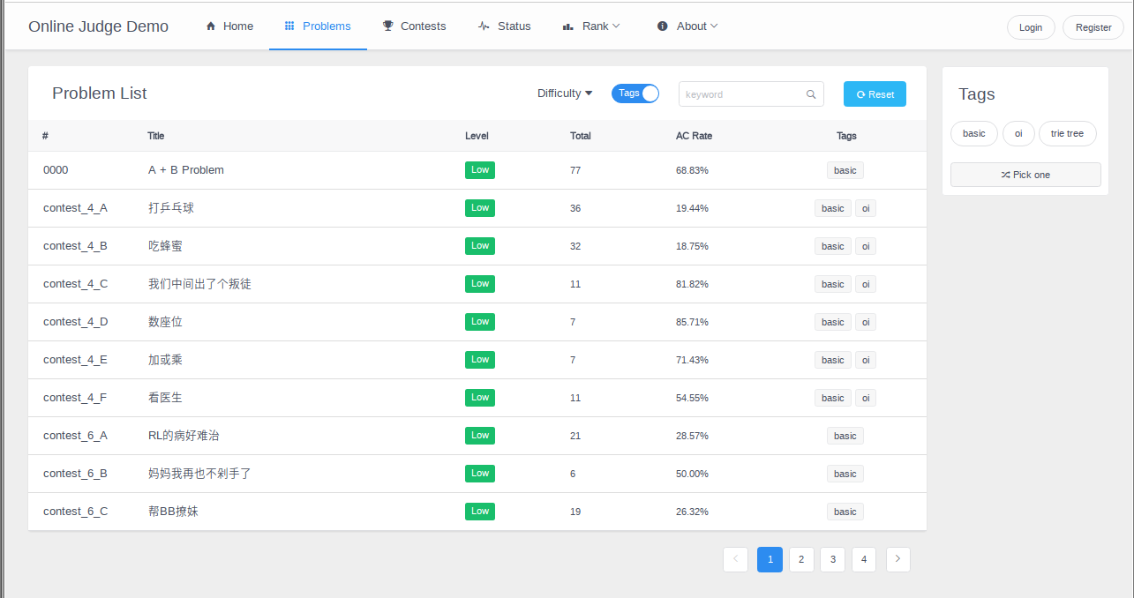
BetterOJ

Slide 39
BetterOJ
Provide a platform for executing codes in the server, and then return the corresponding results (e.g., the error messages, how many test cases have been passed, and score).
Design different user levels such as the highest permission user, question administrator, user administrator, students, etc.
Deliver an approach for adding assignments, competitions or other activities, and give a clear feedback by a ranking list or others
Design it with your own feature, DO NOT simply copy and change from open source

Slide 40
BetterOJ
Bonus hits:
Try to add as many appropriate requirements as possible.
The server can execute as many programming languages as possible.
Place emphasis on the Innovation points from CSE courses in SUSTech.
…
Labor recommendation
Database designer
Front-end designer
Back-end designer
Or other roles determined by you
Stakeholders for Requirements
Hengcheng Zhu

Slide 41
Algorithm store
Customers can customize different algorithms from the website to solve their own problem. (e.g. sorting problem). You can refer to several popular online stores, such as Tao Bao, to design purchase models.
To solve one problem, different algorithms have different prices.
The website can design an approach for customers to upload original data, then run them in the server , and finally feedback the running result to customers in the website.
Customers can check their transaction list.
For other advanced algorithms, you can refer to https://github.com/DEAP/deap
Bonus hits:
Your store can sell as many algorithms as possible.
Refine front-end design.
Using distribute way to running the algorithm.
Design an algorithm interface for programmer to invoke different algorithm easily.

Slide 42
Algorithm store
Labor recommendation
Database designer
Front-end designer
Back-end designer
Or other roles determined by you
Materials
Algorithms can be extracted from open source, while others cannot.
We provide a github link https://github.com/DEAP/deap.
Stakeholders for Requirements
Prof. Peng Yang (CSE)
Zhiyuan Wang

Slide 43
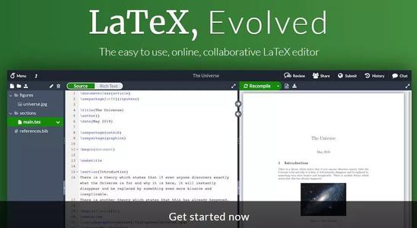
SUSTech Doc

Slide 44
SUSTech Doc
Build a online sharing doc website such that SUSTech users can access and edit the same file.
The website should allow multiple formats, e.g., latex editting (should be able to automatically compile), plain text editting.
For simplicity, you can allow that when one user is editting, other users can only read.
You should also include at least certain fundamental management options, e.g., deleting files, cloning files
You can refer to www.overleaf.com as your guidance (actually it is our oracle; feel free to reproduce any of its features; note that it might be hard to access these days due to...; that is also the reason why we want to build another one for us)
Bonus hits:
You would get a big bonus if you can make it a thourough online sharing doc, i.e., multiple users can edit the files at the same time.
You would get a big bonus if you can realize the automatic dependency building of libraries (espeicially for latex editting).

Slide 45
SUSTech Doc
Labor recommendation
Database designer
Front-end designer
Back-end designer
Or other roles determined by you
Stakeholders for Requirements
Zexin Li

Slide 46




Last but not the least, if you think outsourcing some of your jobs, e.g., drawing, or acquiring certain resources, e.g., cloud services, would be helpful to achieve better performance, just tell us.
Money is not a problem (with certain limitations)!
If you get your work done well, you might get your names to

Slide 47
A Little Something About You

Slide 48
Questions?

